Slide 1

EMBEDDED WEB SERVER
ON LPC2148 WITH ENC28J60 ETHERNET MODULE
Anirudh Nishtala – 225807128
Sumedh Prabhudesai – 225807036
Swaminath B – 225807064
Rishiraj Rakesh Kumar - 225807062

Slide 2
Index
Introduction
Literature Review
Scope of the Project
Objectives
Methodology
Results
Future Scope
Conclusion
References

Slide 3
Introduction
Our project focuses on developing an Embedded Web Server integrated with a Predictive Maintenance System.
This solution enables real-time monitoring and remote management of industrial/electronic equipment, predicting failures before they occur, and reducing downtime.
The system enhances operational efficiency by combining embedded technology with data analytics.

Slide 4
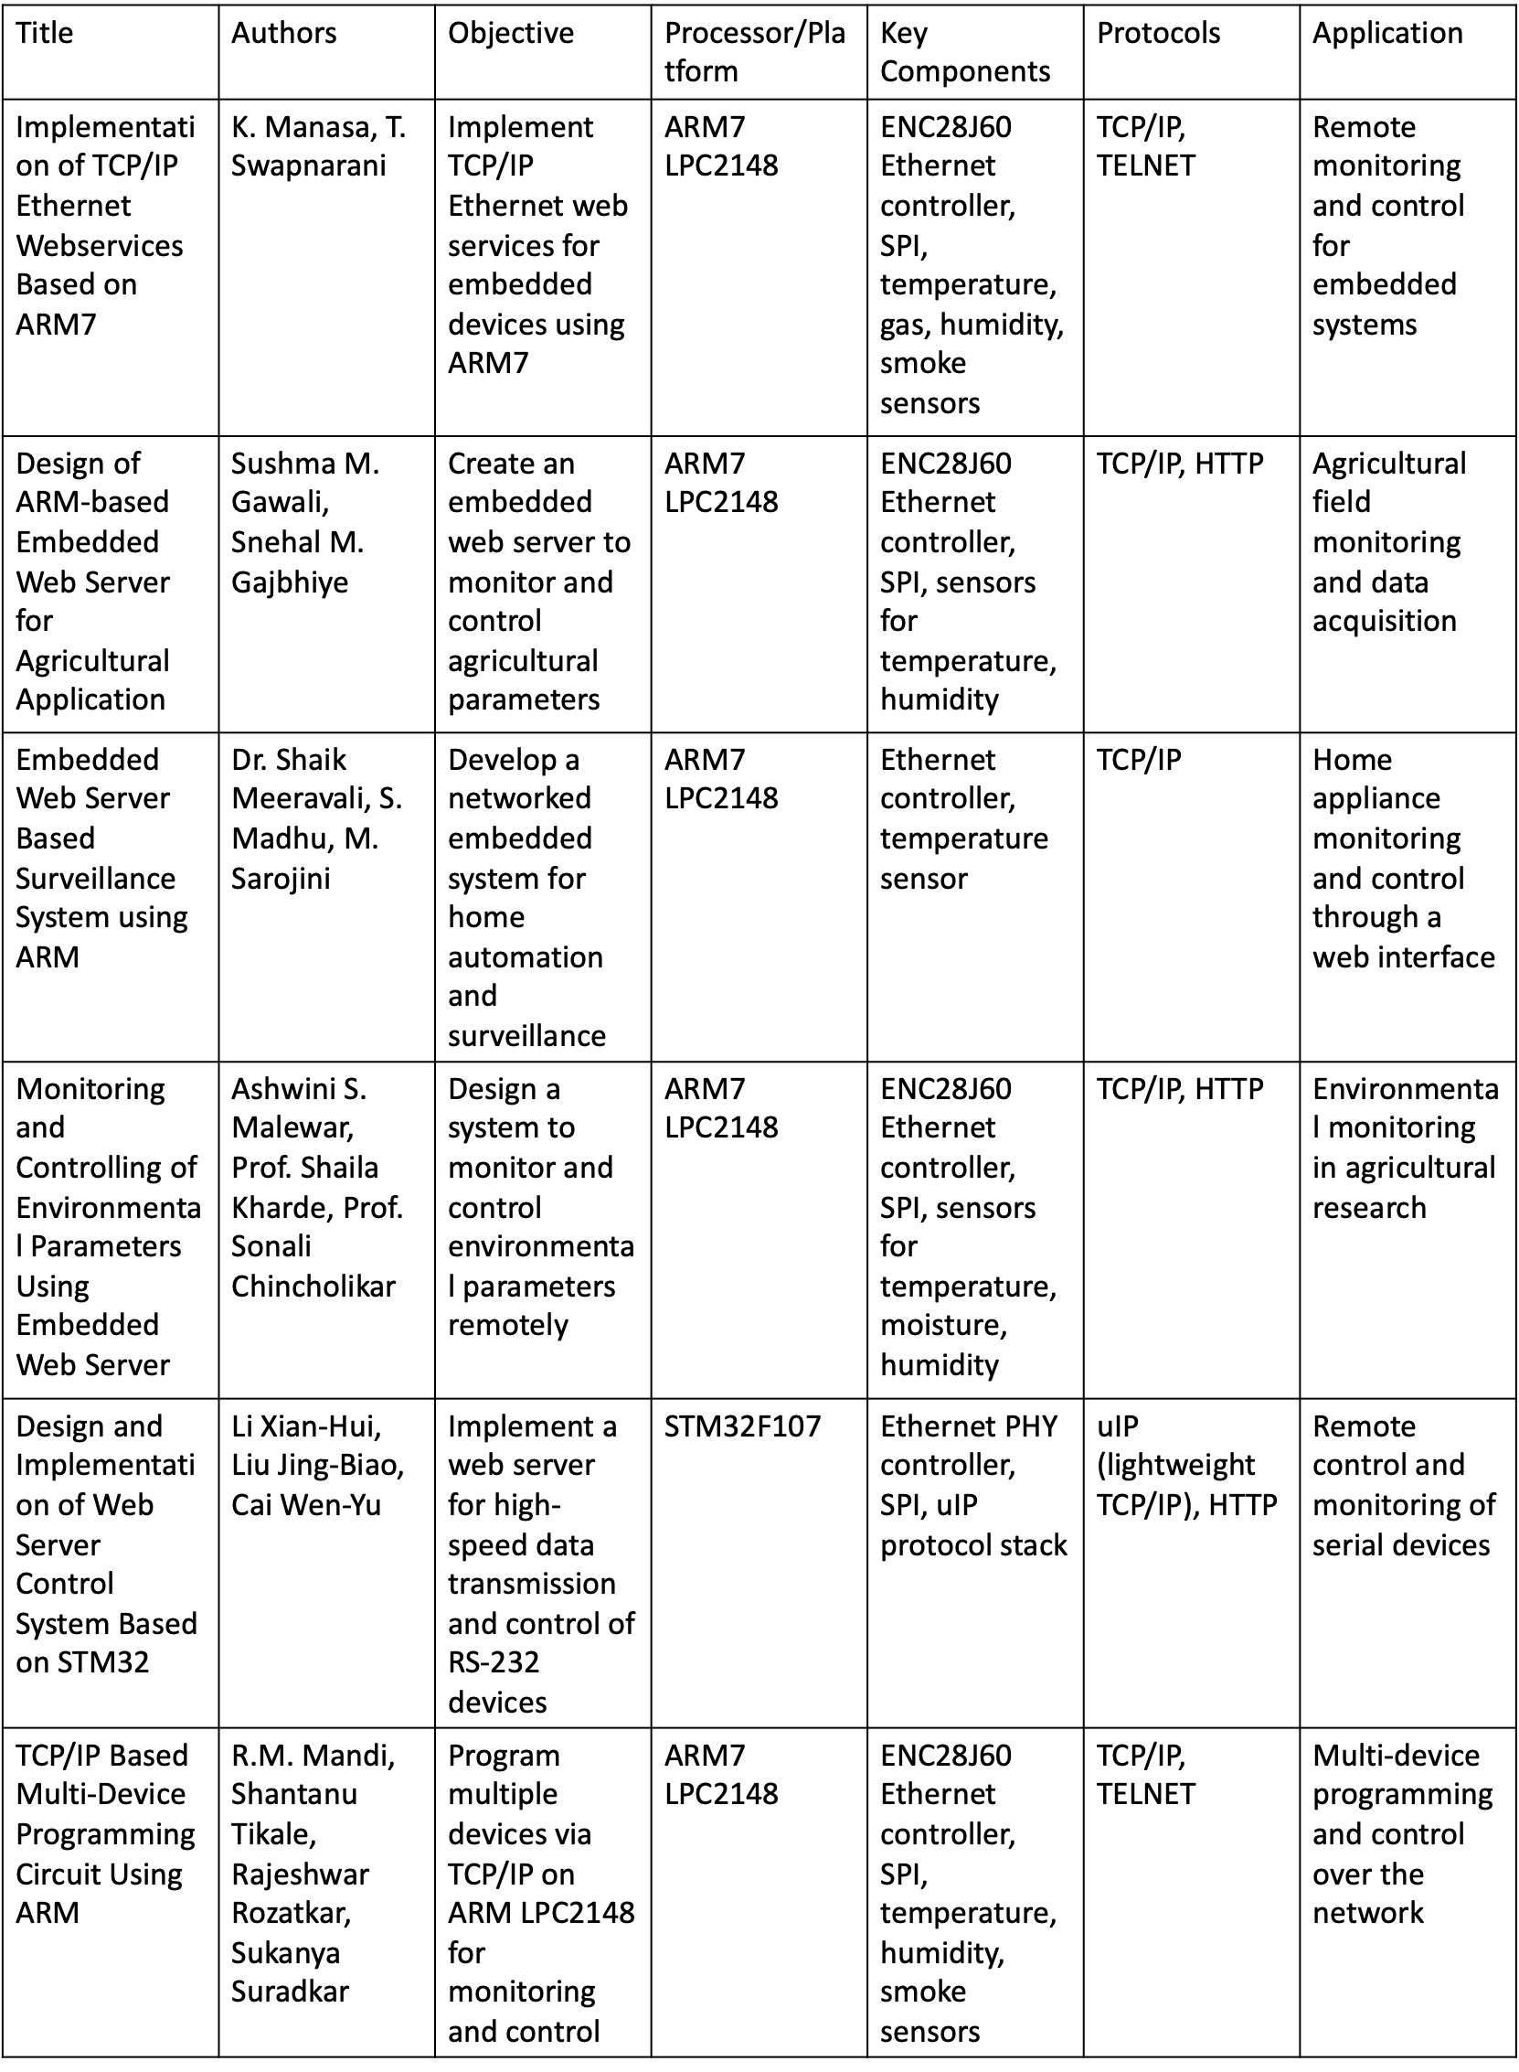

Slide 5
Literature Review

Slide 7
Scope of the project
The scope of this project includes making an embedded web server on LPC2148 using an ethernet module ENC28J60 responsible for data transmission and retrieval and built a predictive maintenance system to optimize equipment maintenance and reduce downtime.
Inclusions:-
LPC2148 microcontroller, ENC28J60 ethernet module, Mongoose Web Server Framework, HTML, CSS, Python, mySQL and Flask.
Embedded web server development
Real-time data monitoring.
Implement TCP/IP stack.
Develop a user-friendly web interface.

Slide 8
Objectives
The objective of this project is to develop an efficient and reliable Embedded Web Server using LPC 2148 and ENC28J60 ethernet module. The key goals include:-
Real-time Monitoring: Enable continuous monitoring of industrial equipment via a web interface.
Data Acquisition and Transmission: Sensors embedded in the equipment continuously capture key performance data, which is then processed and transmitted to the web server.

Slide 9
Methodology
Creating the web server
Simulating the sensor data on the server
Building the backend
Designing the frontend

Slide 10
CREATING THE WEB SERVER

Slide 11
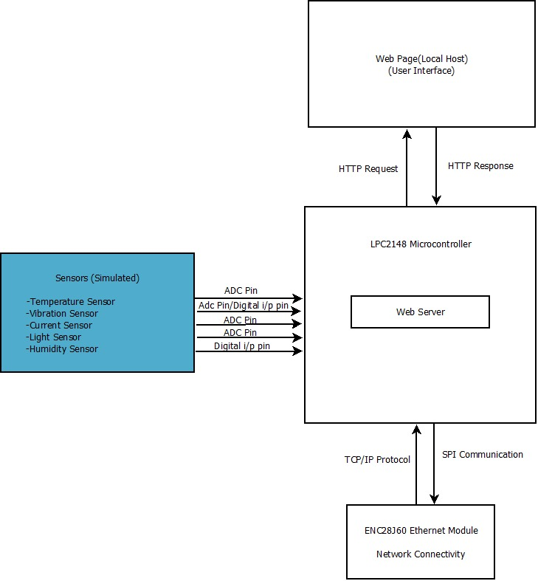
System Architecture:-

Slide 12
Server Design
Integrated the Mongoose framework to establish HTTP server capabilities on the LPC2148.
Configured SPI-based communication between the LPC2148 and the ENC28J60 Ethernet module.
Compiled and generated a .hex file for deployment on the LPC2148, enabling real-time data transmission.

Slide 13
Mongoose Framework and Server Setup
Why Mongoose?
Lightweight HTTP Support: Ideal for embedded systems with constrained resources.
Efficient Data Handling: Supports HTTP requests directly on the LPC2148, optimizing memory usage.
Server Configuration:
SPI Communication: Established SPI protocol to interface the ENC28J60 Ethernet module with the LPC2148.
Network Setup: Configured essential TCP/IP parameters (e.g., IP address, gateway) for network functionality.
Real-Time Data Simulation: Programmed the LPC2148 to capture and simulate sensor data for transmission over HTTP.

Slide 14
Code Compilation, Deployment, and Results
Code Compilation and Deployment:
Cross-compiled the source code to generate a .hex file compatible with the LPC2148.
Flashed the .hex file onto the microcontroller, initiating real-time data transmission over HTTP.
Testing and Results:
Validated the functionality of real-time data transmission via Ethernet.
Verified accurate data display on the frontend after integrating with a backend setup using SQL and Flask.

Slide 15
Simulation of Sensor Data on the Web Server

Slide 16
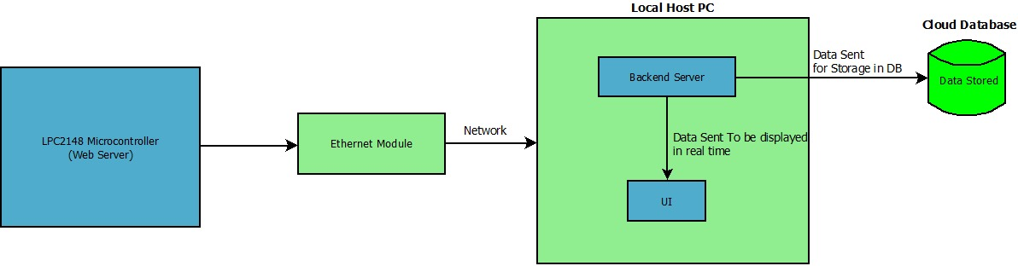
Working Procedure:-

Slide 17
Simulation of Sensor Data on the Web Server
Objective: Simulate sensor and actuator data due to limited physical resources.
Data Generation:
Data Simulation: Generating sensor data through a C code and integrate it with Python Flask background process and the MySql database to store the data.
Types of Data: Temperature, humidity, and pressure readings simulated based on industry test data.
Data Flow:
Generated data is sent to the backend and stored in the database and then eventually sent to the web server and displayed on the web page.
Shortcomings: Untested in real life situations and realistic industry environment.

Slide 18
Backend Development

Slide 19
Overview of Key Components
Library Loading
The load_library() function loads a shared library (libmylibrary.dll or libmylibrary.so) using ctypes. It initializes the ENC28J60 Ethernet module and sets function signatures. Error handling provides detailed feedback for troubleshooting library loading issues.
Database Connection
The connect_to_database() function establishes a connection to a MySQL database using specified configuration details. The store_sensor_data() function inserts sensor readings into a database table. It includes error handling for connection problems, ensuring robust data storage.
Data Retrieval
The get_sensor_data_from_c() function calls C functions to retrieve real-time sensor data. It utilizes a defined SensorData structure to format the data and converts it to JSON for easy use within Python.

Slide 20
Application Functionality
Background Thread
The background_data_collection() function runs in a separate thread, fetching sensor data every 2 seconds. This ensures continuous data collection and storage without disrupting the main application’s functionality.
Web Application
Utilizing Flask, the code sets up a web interface and API. The / route displays the latest 10 sensor records, while /api/current and /api/historical provide JSON data for real-time and historical sensor information. This design facilitates easy access to sensor data for both users and applications.

Slide 21
Frontend Development

Slide 22
Overview of Embedded Systems Dashboard
Purpose:
The dashboard provides real-time monitoring of sensor data for embedded systems.
Built with HTML, CSS, and JavaScript, it uses Chart.js for data visualization and allows dynamic interaction with data.
Key Components:
CSS for Styling:
:root defines color themes for light and dark modes.
Flexbox layout is used to create a responsive sidebar and main content area.
Interactive effects (e.g., hover, theme toggle) enhance user experience.
HTML & CSS Styling
Utilizes a modern layout with a flexible design.
CSS styling includes custom properties (--bg-color, --text-color, etc.) for easy theme management.
Responsive Design: Ensures the interface adjusts for different screen sizes.
Main Content Area:
Header with title, theme toggle button, and logout option.
Sensor cards to display current sensor readings with real-time status updates (e.g., "Normal," "High").

Slide 23
Real-time Data Display with Dynamic Status
Real-time Data Update Functionality:
JavaScript Functions:
updateSensorData(): Fetches sensor data from the backend API (/api/current) and updates sensor values on the dashboard.
Status Indicators: Each sensor reading has a status badge (e.g., "Good," "Warning") updated based on preset thresholds.
Automatic Refresh: Uses setInterval to refresh data every second, ensuring real-time updates.
Theme Toggle:
toggleTheme() Function: Switches between light and dark modes by toggling data-theme on the <body> element.
Uses CSS variables (--bg-color, --text-color) for easy theme management.
Provides a more visually accessible interface for users based on preference.
Data Display Cards
Cards for Sensor Data: Timestamp, Temperature, Voltage, Pressure, and Magnetic Field.
Each card shows current sensor readings with:
Data values updated every second.
Status indicators (Good, Warning, Danger) based on value thresholds.
Real-time Status Update Logic
updateStatus function updates card statuses:
Values outside defined thresholds trigger color-coded statuses:
Green: Normal
Orange: Warning
Red: Danger
API Fetching: Data is fetched from /api/current every second using fetch().
Error Handling: If the data fails to load, an error is logged in the console.

Slide 24
Data Visualization with Chart.js
Chart.js Integration:
Chart Initialization:
Four line charts display trends of different metrics (Temperature, Voltage, Pressure, Magnetic Field).
Each chart is customized with color-coded lines for easy distinction and scales based on time (x-axis) and sensor data (y-axis).
Dynamic Chart Updates:
updateChart() Function: Adds new data points to each chart as they are received from the API.
Data Limit: Keeps only the last 10 data points for clear visualization without cluttering.
Chart Initialization and Updates
Initialization: Each chart is initialized with a specific dataset and color theme.
updateChart Function:
Adds timestamps and sensor values to the chart’s dataset.
Keeps charts updated with the latest information while maintaining a clean UI.

Slide 25
Project Outcomes
Results: Successfully developed and tested a functional prototype of an embedded web server.
Future Prospects: Potential to replace simulated data with real sensors or deploy on different microcontrollers.

Slide 26
Results

Slide 27
⁠Web Server Functionality
Result: Successfully established a functioning embedded web server on the LPC2148 microcontroller using the ENC28J60 Ethernet module.
Highlights:
Achieved basic web server response for control and data requests.

Slide 28
⁠Sensor Data Simulation
Result: Successfully simulated sensor data in real-time, representing temperature, humidity, and pressure values.
Highlights:
Integrated DLL in Python Flask
Data consistency and real-time updates verified through backend processing and frontend display.

Slide 29
Backend Stability and Data Storage
Result: Developed a robust backend system using Python Flask and MySQL.
Highlights:
Database performance tested under continuous data writing and query load, with stable results.

Slide 30
Frontend Interface and User Experience
Result: Responsive frontend showcasing real-time sensor data.
Outcome: Users can view sensor data through interactive dashboard.
Highlights:
Real-time dashboard updates verified with simulated data from the backend.

Slide 31
System Integration and Performance Testing
Result: Successfully integrated all components—embedded server, backend, and frontend—into a cohesive system.
Highlights:
System tested for latency and data integrity, showing minimal delay in data updates on the frontend.

Slide 32
Future scope

Slide 33
Testing Electronic Components
Objective: Extend the embedded web server’s functionality to test and monitor various electronic components, such as different ICs, in real time.
Proposed Setup:
Circuit with IC and Sensor: Set up a circuit on a breadboard with an IC, power supply, and a sensor (e.g., current sensor) to monitor parameters like current.
Connection to LPC2148: Connect this breadboard setup to LPC2148 for data acquisition and processing.

Slide 34
Data Acquisition, Processing, and Future Enhancements
.hex File Customization:
Implement a function in the main.c file to acquire and process this data from the sensor in real time.
Mention the hardware pin configurations for initializing communication peripherals between the sensor(s) and the microcontroller.
Data Flow:
Sensor Data Capture: The LPC2148 captures data from the current sensor
Backend Processing: Data is sent to a backend system (SQL and Flask) to be analyzed and stored.
Frontend Display: Real-time results are accessible through the web server for remote observation.
Scalability and Applications:
Additional sensors (e.g., voltage, temperature) could be integrated for comprehensive testing.

Slide 35
References
Manasa, K., & Swapnarani, T. (2013). Implementation of TCP/IP Ethernet Webservices Based on ARM7. International Journal of Mathematics and Computer Research, 1(1), 20-24​(
Gawali, S. M., & Gajbhiye, S. M. (2014). Design of ARM based Embedded Web Server for Agricultural Application. International Journal of Computer Science and Information Technologies, 5(1), 354-356​
Meeravali, S., Madhu, S., & Sarojini, M. (2013). Embedded Web Server Based Surveillance System using ARM. International Journal of Engineering Research & Technology, 2(8), 1912-1915​
Malewar, A. S., Kharde, S., & Chincholikar, S. (2016). Monitoring and Controlling of Environmental Parameters Using Embedded Web Server. International Journal of Advanced Research in Computer and Communication Engineering, 5(2), 373-375​
Xian-Hui, L., Jing-Biao, L., & Wen-Yu, C. (2012). Design and Implementation of Web Server Control System Based on STM32. Fifth International Conference on Intelligent Networks and Intelligent Systems, 146-148​
Mandi, R. M., Tikale, S., Rozatkar, R., & Suradkar, S. (2015). TCP/IP Based Multi-Device Programming Circuit Using ARM. International Engineering Research Journal (IERJ), 1(11), 1388-1391​
https://www.youtube.com/watch?v=Z1RJmh_OqeA
https://mongoose.ws/reference-projects/
https://embetronicx.com/tutorials/microcontrollers/lpc2148/ultrasonic-sensor-interfacing-with-lpc2148/

